Slide 1
IEEE Member Discount:
Save an Additional 50% on IEEE eLearning

Slide 2
IEEE Member Discount: Save an Additional 50% on IEEE eLearning
How did we get here?
As a result of IEEE Sections Congress 2020, IEEE members voted on three recommendations, including one to provide continuing education to provide true value added for working professionals.
One of the efforts included in this recommendation was to support member retention by offering three IEEE eLearning courses per year to members.

Slide 3
IEEE Member Discount: Save an Additional 50% on IEEE eLearning
How did we get here?
This effort also aligns with the IEEE Strategic Plan for 2020-2025, particularly the Institute’s goals to:
Be a trusted source of educational services and resources to support life-long learning
Provide opportunities for career and professional development

Slide 4
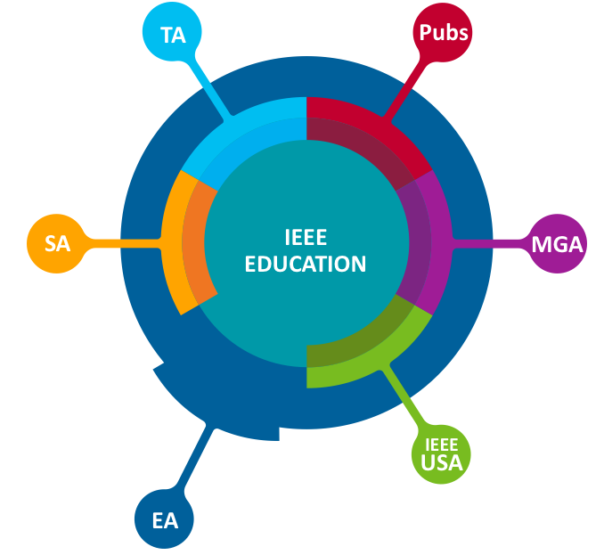
IEEE Member Discount: Save an Additional 50% on IEEE eLearning
How did we get here?
Many areas of IEEE provide eLearning and continuing education products

Slide 5
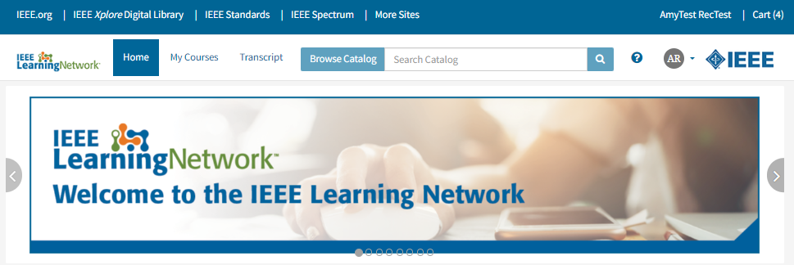
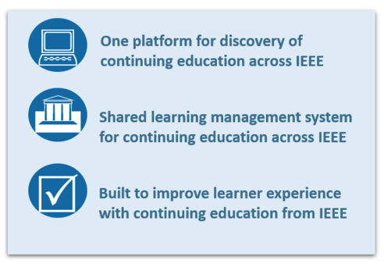
Notes:
Much of this continuing professional education can be found on the recently launched IEEE Learning Network, which features over 1,000 courses in engineering, technology, and career development. The IEEE Learning Network, or ILN, brings together content in an easy-to-use portal and learning management system that lets learners easily search for specific topics or technologies, keep track of your progress in each course, and even instantly print certificates upon successful completion of course assessments.

Slide 6
41 IEEE Partners on ILN
Intellectual Property Rights

Slide 7
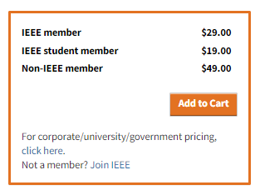
IEEE Member Discount: Save an Additional 50% on IEEE eLearning
How is this different than existing discounts?
The vast majority of ILN courses already offer a member rate
Functionality already existed within the IEEE enterprise cart to allow for additional discounts using a promotion code or promotion link
It was essential that this discount present itself to members during the checkout process so that members don’t need to remember/possess a promotion code or link
Many teams across IEEE OUs and staff worked together to create this IEEE enterprise cart functionality. A great example of working across the aisle!

Slide 8
IEEE Member Discount: Save an Additional 50% on IEEE eLearning
What does this discount include?
Now, members can choose from 300+ courses to save an additional 50% on three eLearning courses per member year!

Slide 9
IEEE Member Discount: Save an Additional 50% on IEEE eLearning
What does this discount include?
Topics include courses in:
Career Development
Computing and Processing
Emerging Technologies
Power, Energy and Industry Applications
Transportation
And more!
(If your Society or OU offers educational content via ILN and wants to include their content in this offer, email ILNinfo@ieee.org)

Slide 10
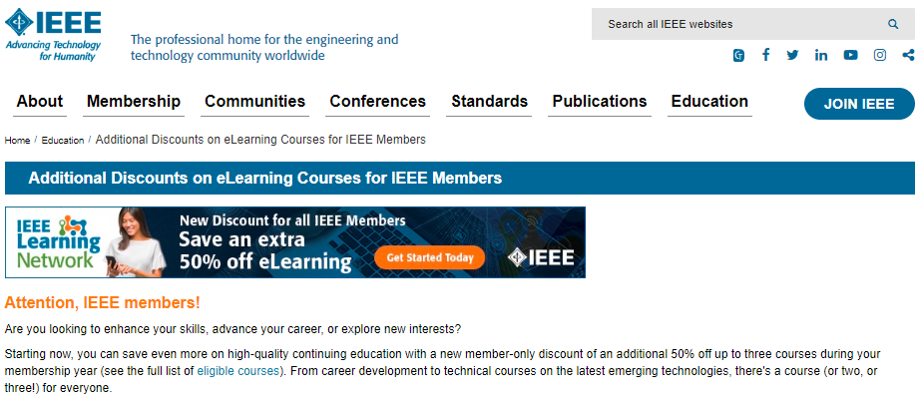
IEEE Member Discount: Save an Additional 50% on IEEE eLearning
How can I access this offer?
You MUST be an active IEEE member.
Identify up to three eligible courses to purchase.
Visit the IEEE Learning Network and sign in with your IEEE personal account (the same account you use to purchase/renew your IEEE membership)
Search for the courses you’re interested in and add them to your cart. Proceed to checkout.
The additional 50% discount will automatically be available via the Payment page during checkout. Be sure to select the products you wish to discount and click “Apply Discount Selection” before proceeding to the Review Order page.
Complete your purchase.
Start learning! Your course is available immediately on-demand.
Visit www.ieee.org/education/mud.html
A step-by-step guide walks you through the process

Slide 11
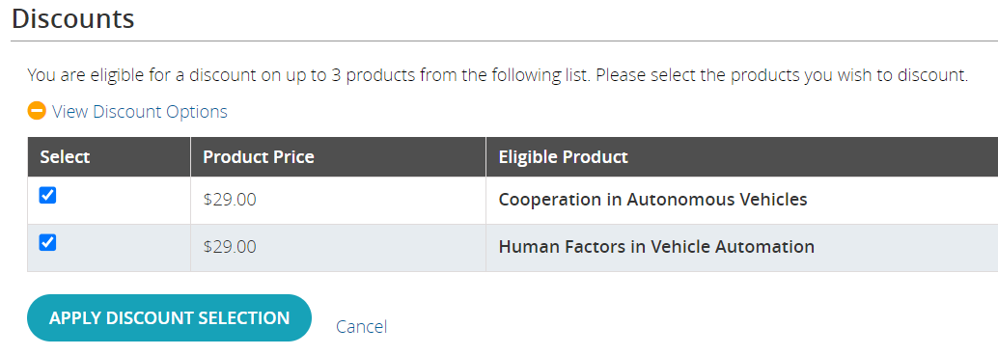
IEEE Member Discount: Save an Additional 50% on IEEE eLearning
What else should I know?
Remember to apply your discount selection on the Payment page in order to receive your discount.
Don’t want to buy all three courses at once? You can take advantage of this offer until the end of this membership year, and can purchase the courses in up to three separate transactions.
Plus: After you renew your membership for the next year, your eligibility will restart and you will be able to access three more courses at this special rate!

Slide 12
Visit the IEEE Brand Experience Toolkit:
brand-experience.ieee.org/toolkits/ieee-elearning-discount
Share Within Your Networks
How can we do that?
You will find:
Social media copy
Newsletter blurb copy
Variety of images in different sizes (static + animated)
180x150
300x250
600x200
728x90
200x628
1300x280
Share the information with your members via:
Social media channels
Newsletters
E-mail campaigns
Websites
Anywhere your members receive digital information

Slide 18
Share Within Your Networks
Where else can we find information about this offer?
MGA placement
Arrears messaging
Member Benefit Bulletins throughout the year
Lead gen program
Renewals messaging in the fall
E-mail banners
New member benefit for 2024
Message in the New Member Onboarding
Message the post-renewal engagement series
EA placement
ILN carousel image
Built into EA marketing/promo efforts via email, social media, newsletters + more!
Other placement
IEEE Brand Experience website
IEEE.org homepage
SCOOP, Society Sentinel, TA, IEEE-OU promotion
IEEE social media alias
Think of existing customers + prospective members
Sections Congress
Include in communications/emails to members about Sections Congress
Include a flyer in the attendee bags + with anyone who will have a table
Share ad for rolling screen
Share a presentation/slide with people presenting

Slide 19
Questions?
CPEsupport@ieee.org

